Slide 1

Poba Medical Hardware Check 2
Michael Bransky, Noah Keyes, Vergil Sorg

Slide 2
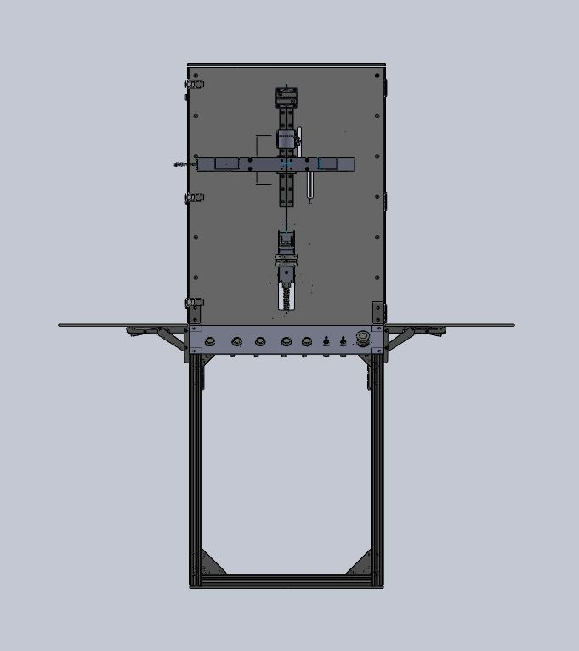
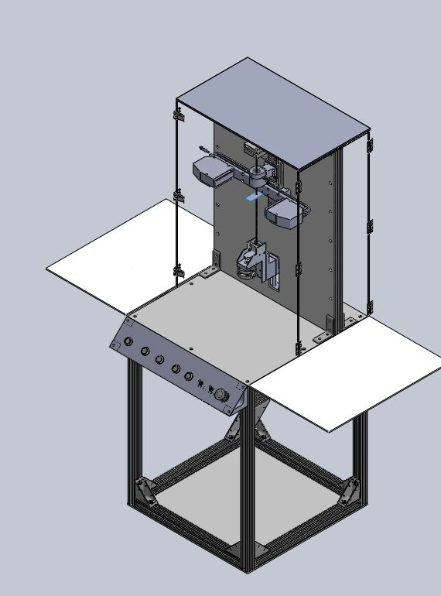
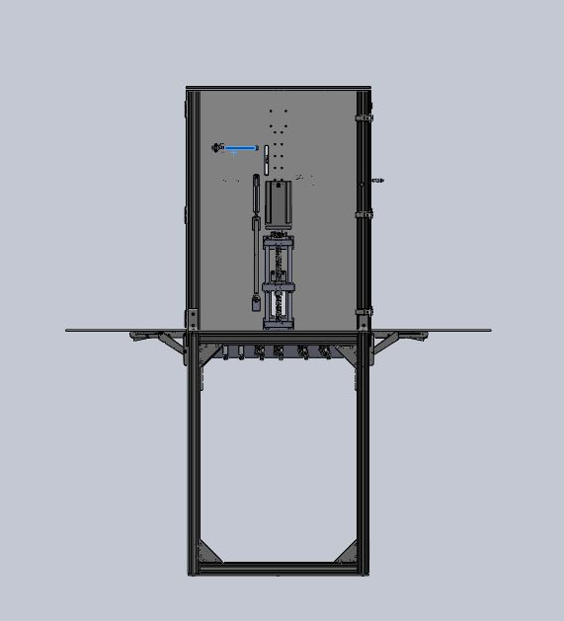
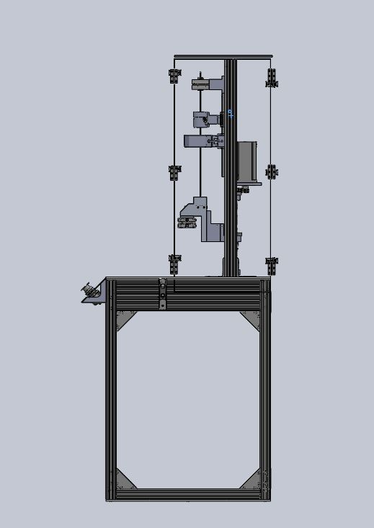
CAD

Slide 3
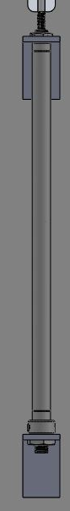
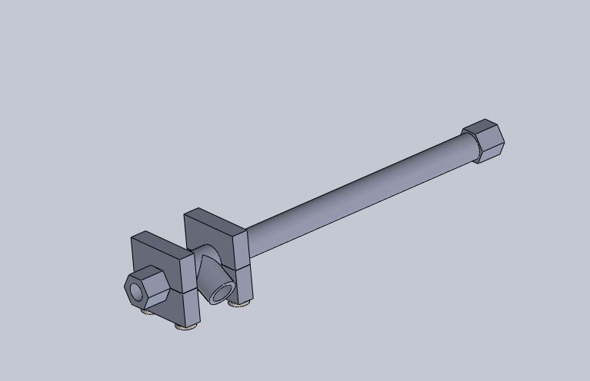
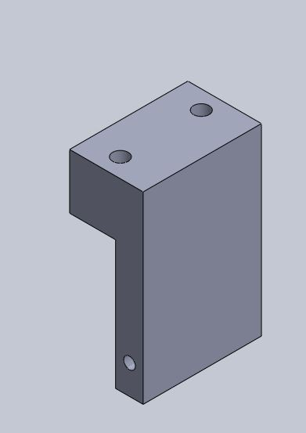
CAD

Slide 4
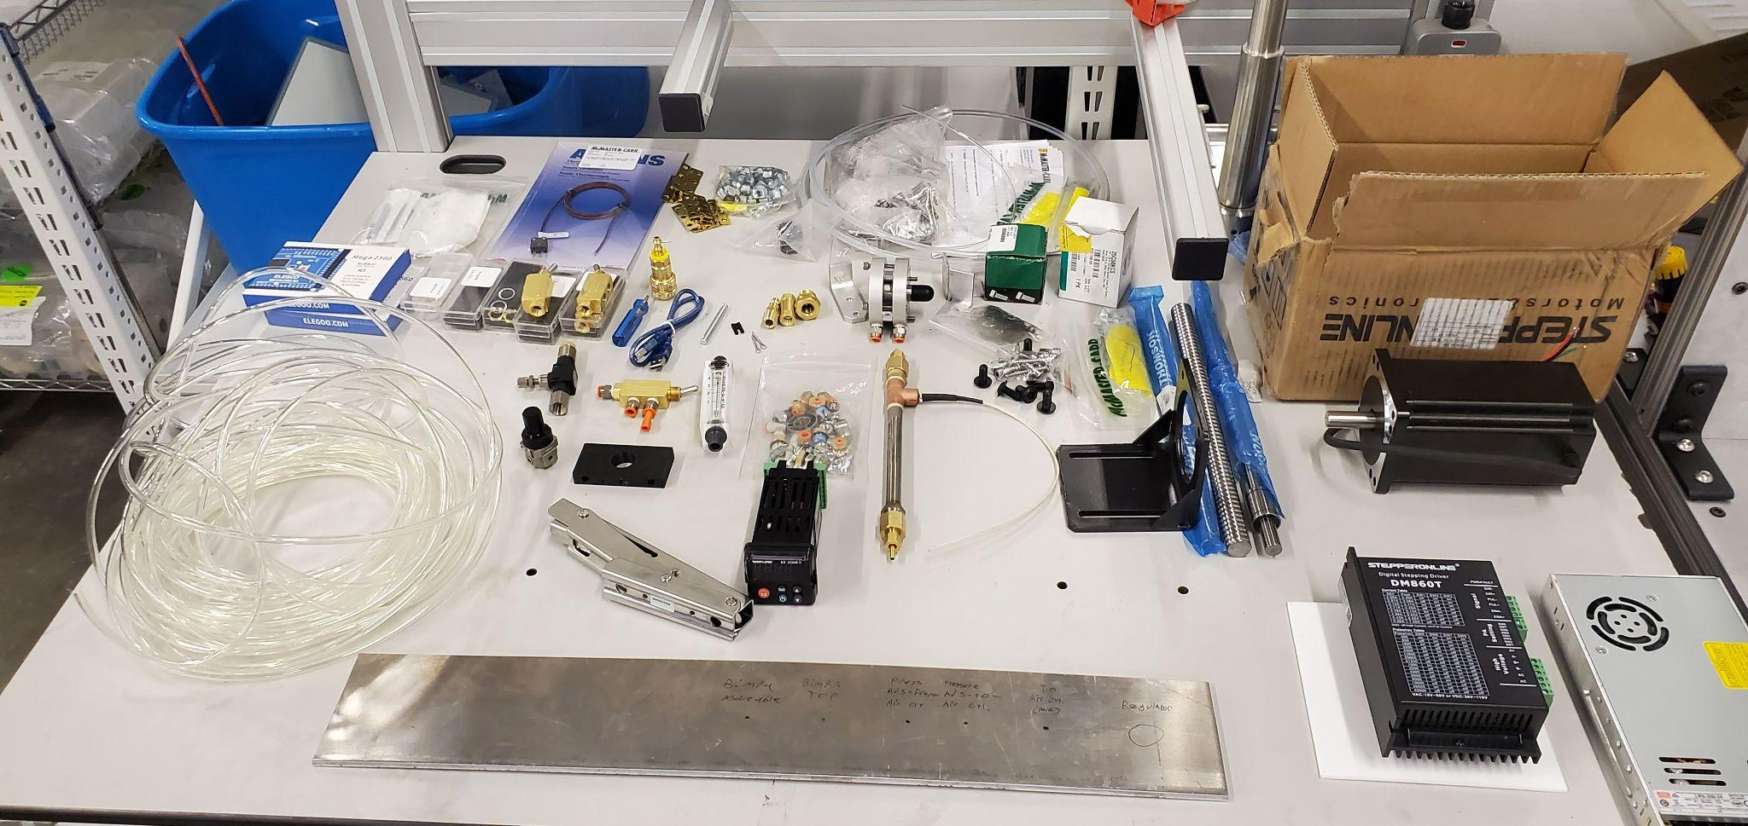
Purchasing Plan

Slide 5
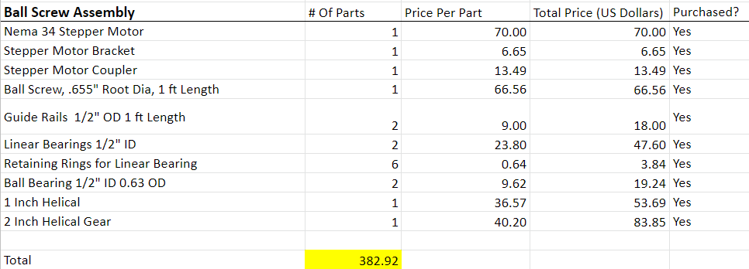
Purchasing Plan

Slide 6
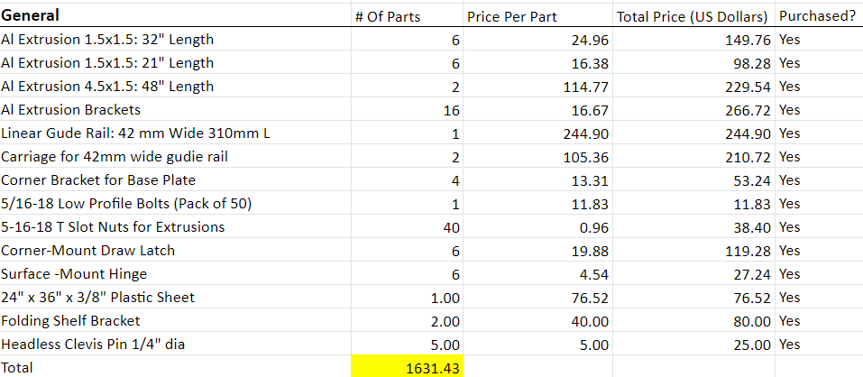
Purchasing Plan

Slide 7
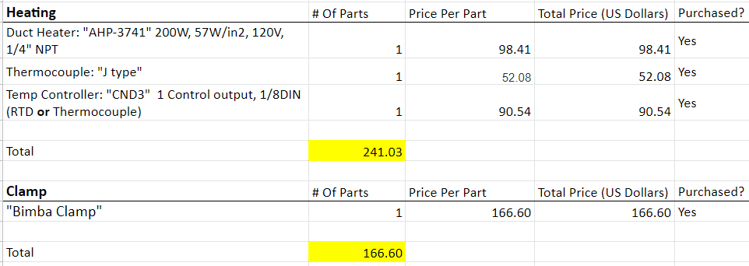
Purchasing Plan

Slide 8
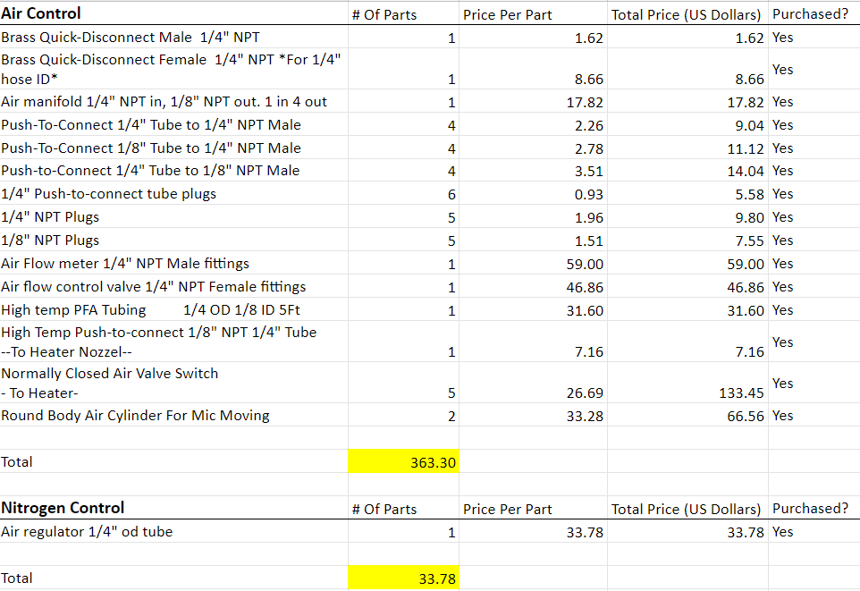
Purchasing Plan

Slide 9
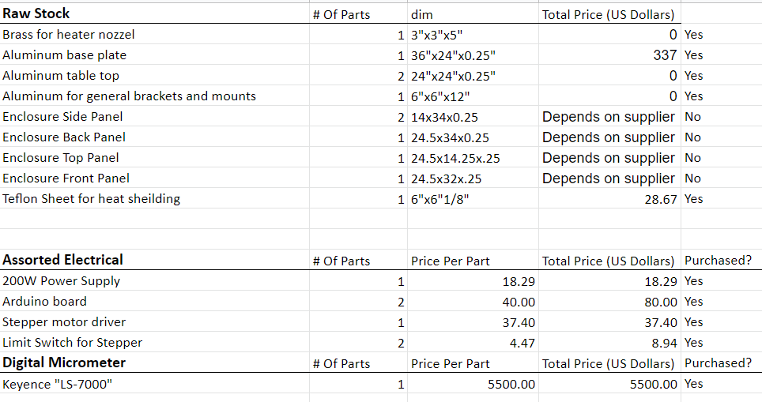
Purchasing Plan

Slide 10
Purchasing Plan
Total Estimated Cost on BOM: $8895.92
Actual Total Expenses: $8986.62
Estimated total was about $90 off the actual total
It is likely that this discrepancy comes from underestimating shipping costs
Purchasing is >90% done, and everything that has been purchased is on hand

Slide 11
Manufacturing plan
Parts which have been manufactured.
All base plates (3)
Ball screw mounts (3)
Ball screw guide rails (2)
Heater nozzles (2)
Button panel (ongoing)
Button panel mounts (2)
Pneumatic cylinder mounts (2)
Side tables (2)
Parts which need to be manufactured.
Ball screw end modification (1)
Enclosure panels (4)
Heater mounts (2)

Slide 12
Manufacturing plan
Total parts which need to be manufactured : 24
Parts which have been manufactured to date : 17
Percentage of parts completed : 71%
Total estimated machining time required: 35 hrs
Total machining time spend producing parts: 30 hrs
Percentage of hours spent machining parts: 86%

Slide 13
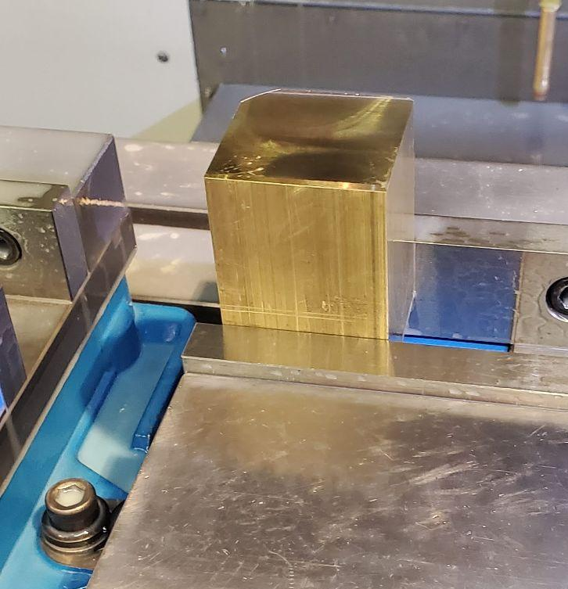
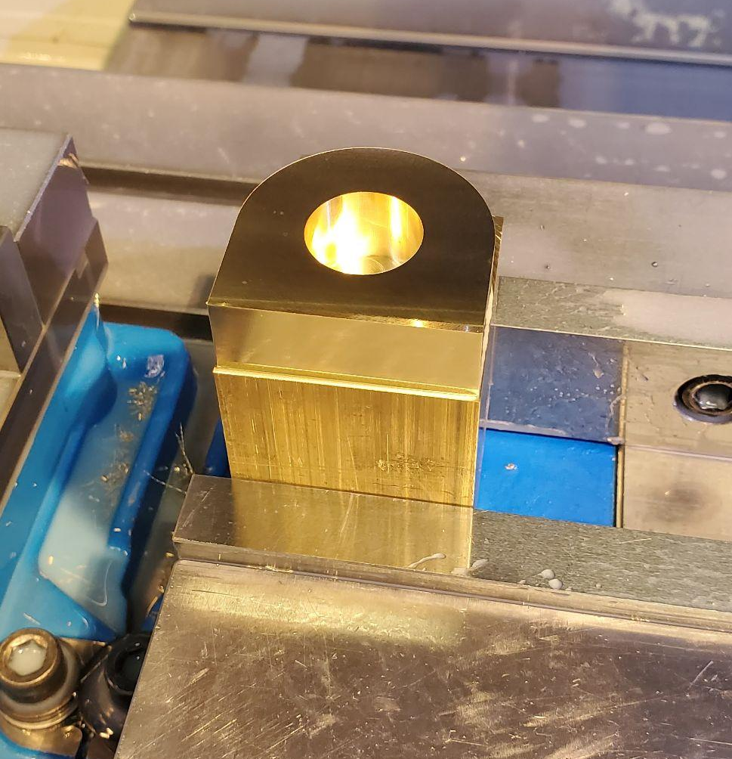
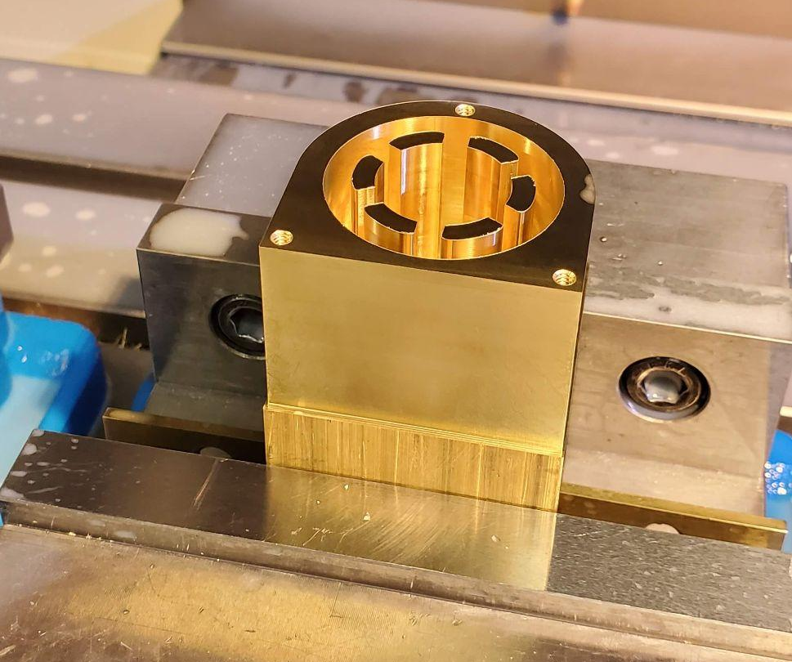
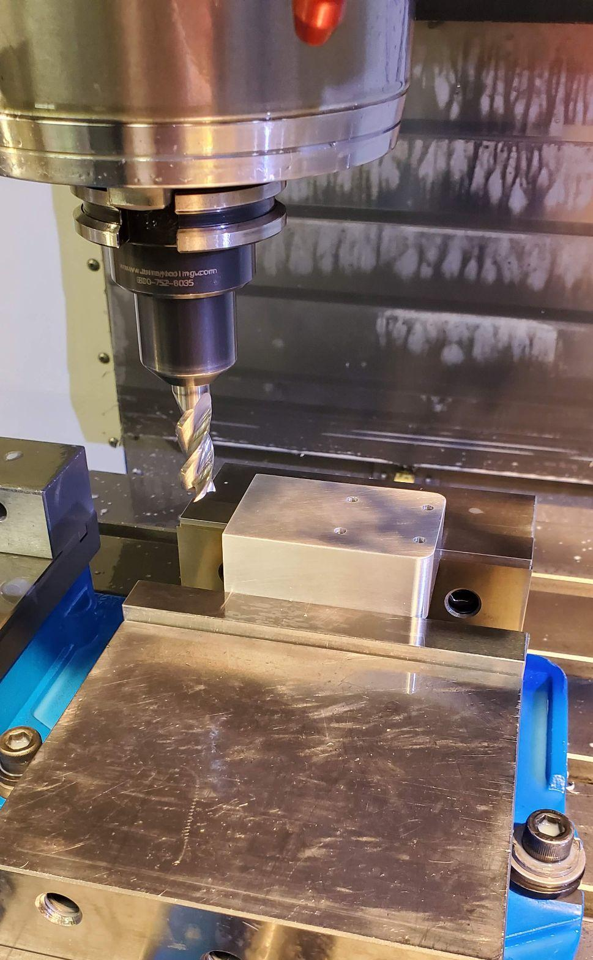
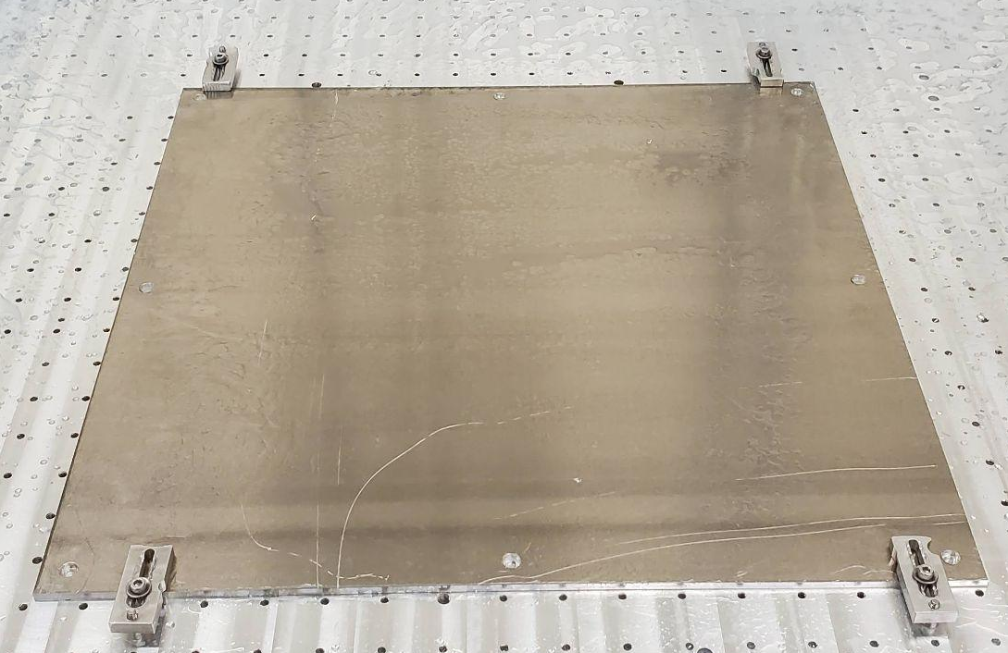
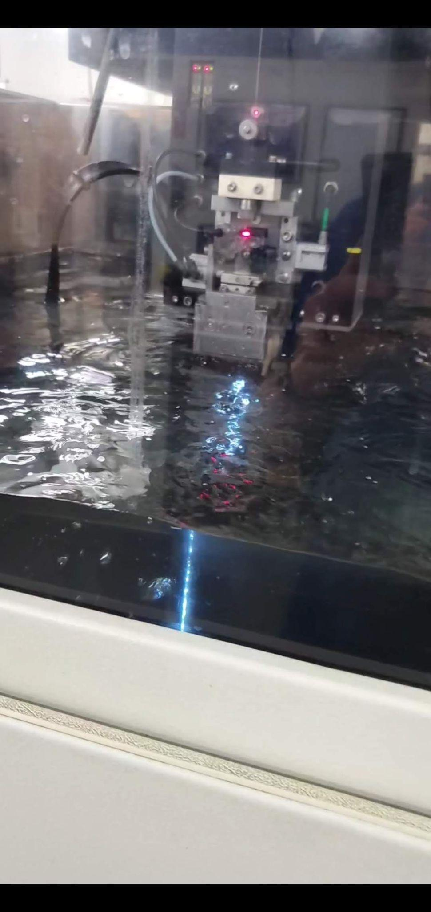
Manufacturing Process

Slide 14
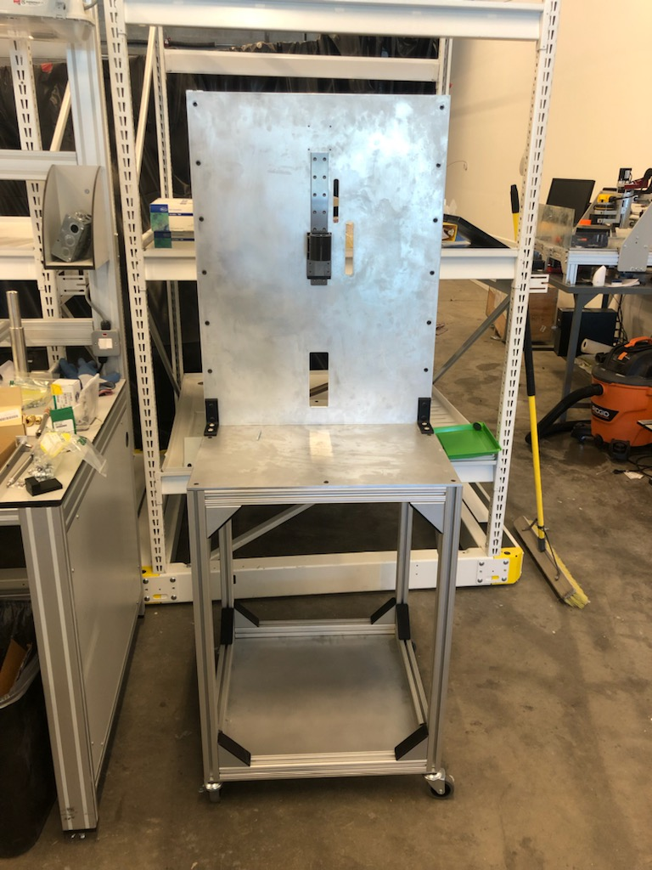
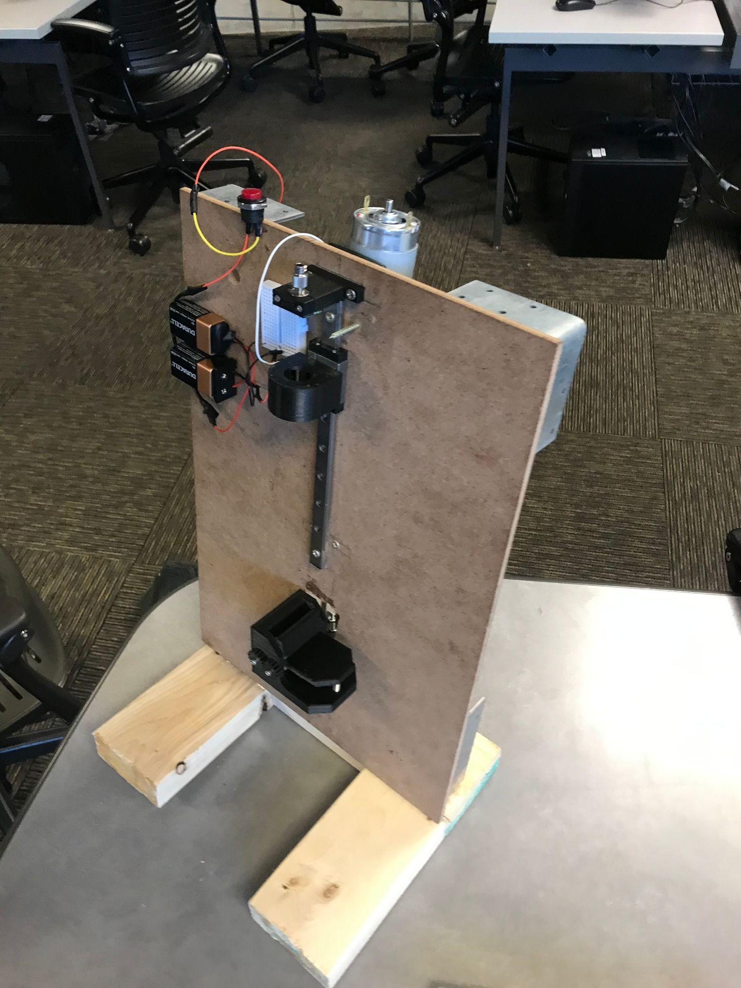
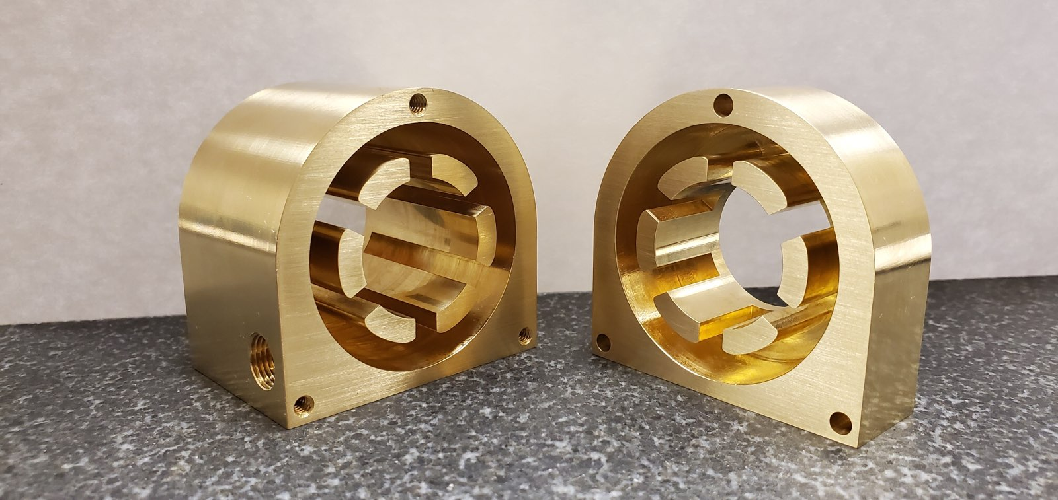
Hardware Demonstration

Slide 15
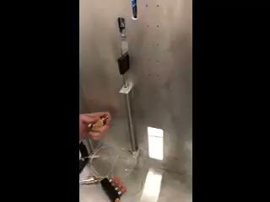
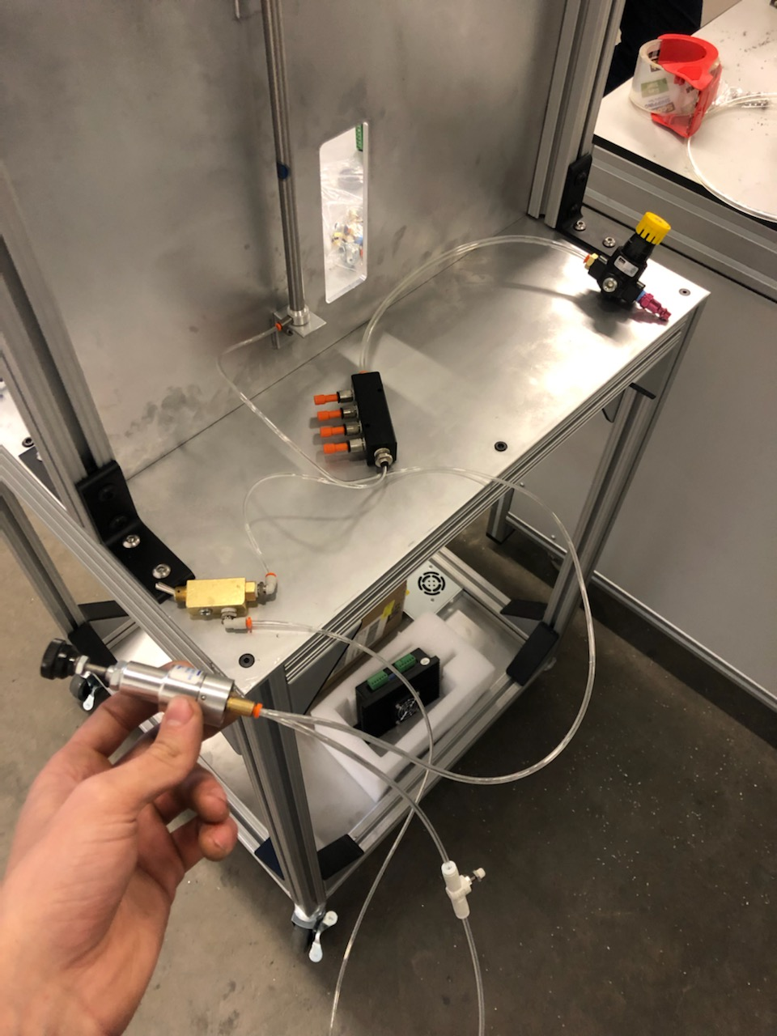
Hardware Demonstration

Slide 16
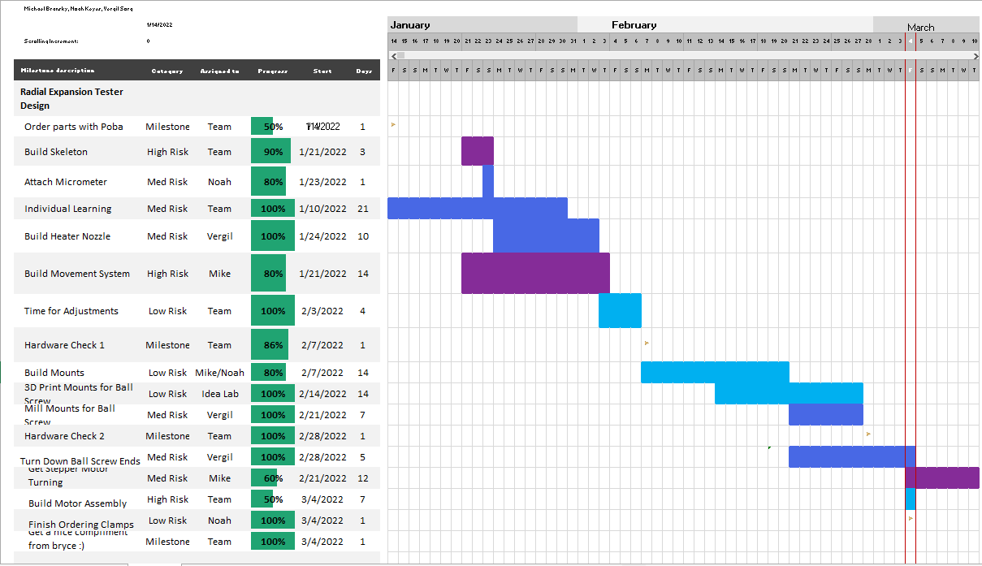
Gantt Chart

Slide 17
Next Steps
Modify Ballscrew
  Ball screws ends will need to be milled to fit into the bearing
Pick up mounts from idealab
  Confirmed order last friday, should be done by Friday, March 4th
  Will need to be replaced for final product
Meeting with Devon to get stepper motor circuit worked out
  Either Wednesday morning or Thursday Afternoon
Get Motor Turning
  By Friday, March 4th
Build mounts for heater
  Thursday, March 3rd - Friday, March 4th
Build Button Panel
  Thursday March 3rd - Friday March 4th
Wiring
  Once everything has been mounted team can focus on wiring the machine
Testing
  Once machine is fully wired, team can focus fully on testing to ensure that machine is working properly

Slide 18
